Slide 1
India Elementary School Data Analysis
Team Name: EduVision Analysts (@Group 24)
Team Members: BBA 3rd Year
G.Pallavi Paralakhemundi campus
D. Varun Kumar
Balaji Mahanty
Y. Satya Sai
Ponuel Mishal

Slide 2
Objectives & Rationale
School Distribution and Access: Analyze number and type of schools (Govt vs Private) across states.
Basic Infrastructure Availability: Evaluate presence of facilities such as toilets, water, and blackboards.
Teacher Strength Across States: Examine distribution of teachers across school types and states.
Infrastructure vs Teacher Availability: Study relationship between infrastructure quality and teacher availability.
Rationale:
Education quality in India depends not only on enrolment but also on school access, facilities, and teacher presence. This analysis aims to find imbalances and improvement areas in elementary education infrastructure.

Slide 3
Data Understanding & Cleaning Summary
Dataset Overview:
Covers elementary schools across Indian states and union territories.
Includes columns on infrastructure (water, toilets, blackboards) and teacher counts by class range (1–5, 1–8, etc.).
Years covered: 2005–2008
Cleaning & Transformations:
Removed duplicates and null values.
Created calculated columns:
  Total Schools
  % Schools with Toilets / Water / Blackboards
  Infrastructure Score
  Teachers per School
Used Power BI DAX measures for aggregations and ratios.
Standardized state names and corrected data types.

Slide 4
Dashboard Design & Structure
Visual Layout:
Map: Total schools by state
Bar Charts: Govt vs Private schools; % schools with facilities
Cards: Key KPIs – District count, Infrastructure Score
Pie Chart: Govt vs Private share
Teacher Bar Chart: Total teachers by state
Scatter Plot (optional): Infrastructure Score vs Teachers per School
Logic Behind Design:
Top Section: Overview KPIs (quick understanding).
Left Section: Teacher-related visuals (human resource view).
Right Section: Infrastructure-focused visuals (facilities view).
Map: Center focus to show regional spread visually.

Slide 5
Key Insights & Analytics
Uttar Pradesh, Andhra Pradesh, and Maharashtra have the highest number of schools and teachers.
Infrastructure disparities exist — some states like Rajasthan and Madhya Pradesh show high school counts but weaker facility availability.
Teacher-to-school ratio varies widely — smaller states like Goa and Sikkim have fewer schools but better teacher availability.
Correlation gap: Some states have good infrastructure but fewer teachers, indicating uneven resource allocation.
Private schools dominate urban states, while government schools dominate rural regions.

Slide 6
Recommendations / Policy Implications
Infrastructure Focus:
Invest in improving toilets, drinking water, and blackboard facilities in underperforming states (e.g., Bihar, Orissa).
Teacher Redistribution:
Introduce teacher deployment policies to balance overstaffed and understaffed regions.
Performance-based Funding:
Link funding to infrastructure improvements and teacher-student ratios.

Slide 7
Learning Summary
Data Understanding:
Gained insights into how government and private schools differ across states in terms of basic amenities and teacher strength.
Analytical Thinking:
Learned to derive meaningful relationships — such as infrastructure versus teacher availability — from raw data using calculated DAX measures.
Power BI Skills:
Enhanced proficiency in data cleaning, visual creation (maps, cards, bar charts, pie charts), and dashboard structuring for storytelling.
Insight Communication:
Developed the ability to convert complex educational data into simple, visual insights that support policy and decision-making.
Key Takeaway:
Data-driven analysis can effectively highlight educational disparities, helping policymakers and educators focus on states that need the most attention and funding in the coming years.

Slide 8
Conclusion
The India Elementary School Data Analysis Dashboard provides a clear overview of how schools across states perform in terms of infrastructure, accessibility, and teacher availability.
The analysis reveals that:
Uttar Pradesh, Madhya Pradesh, and Maharashtra have the highest concentration of schools and teachers.
Several states, particularly in the North-East and Central India, show limited infrastructure facilities like toilets, water, and blackboards, indicating regional inequality.
Government schools dominate the rural landscape, while private schools are more concentrated in urbanized states.
The infrastructure score and teacher availability do not always move together, meaning strong physical facilities do not necessarily ensure adequate teaching staff.
Overall, the findings highlight the need for balanced investment — improving both infrastructure and human resources simultaneously to achieve equitable education access.

Slide 9
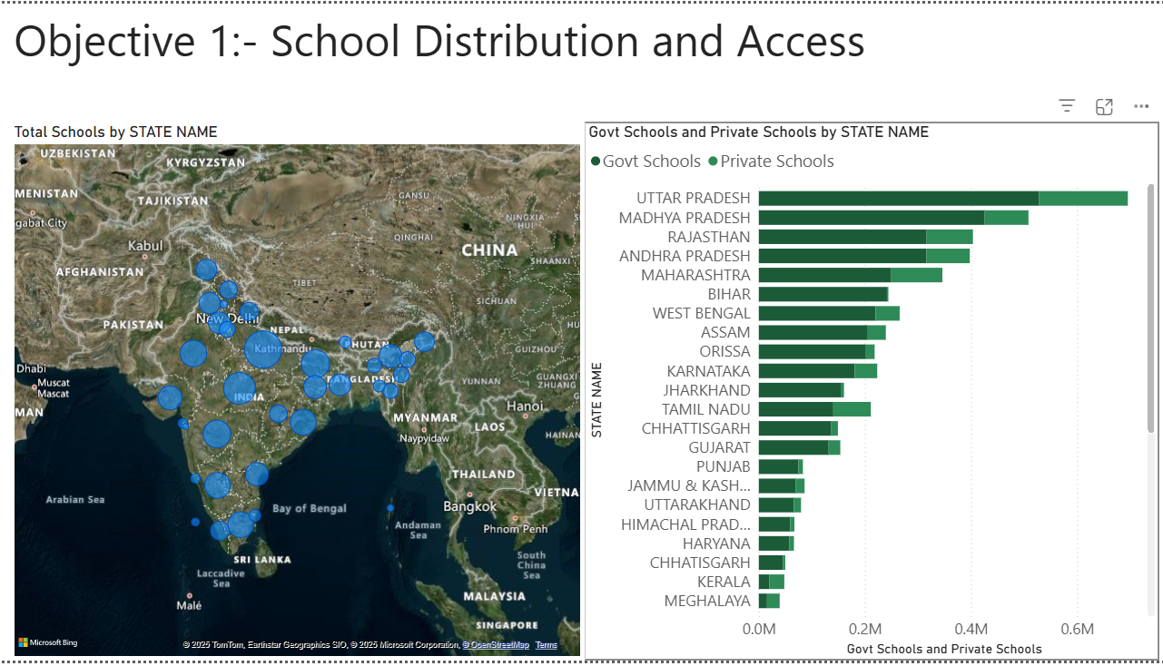

Slide 10
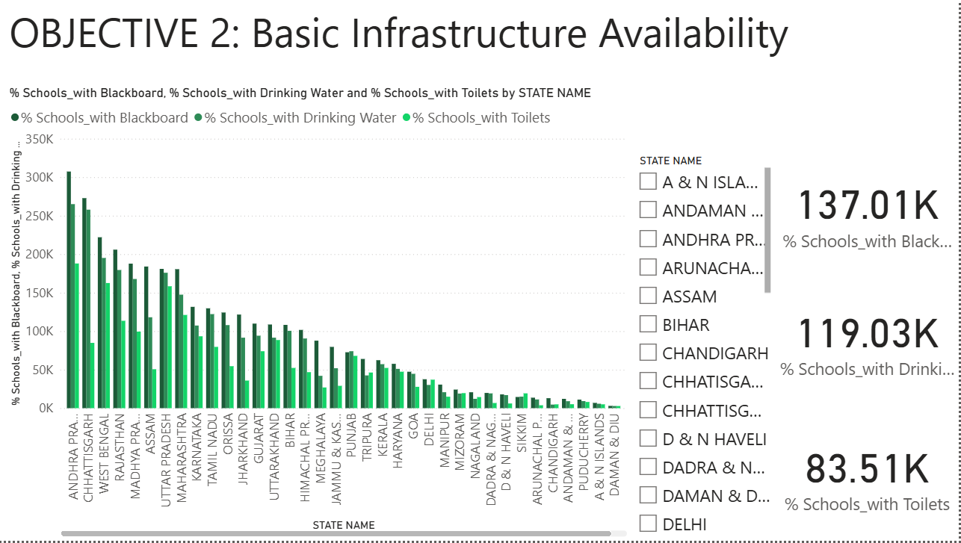

Slide 11
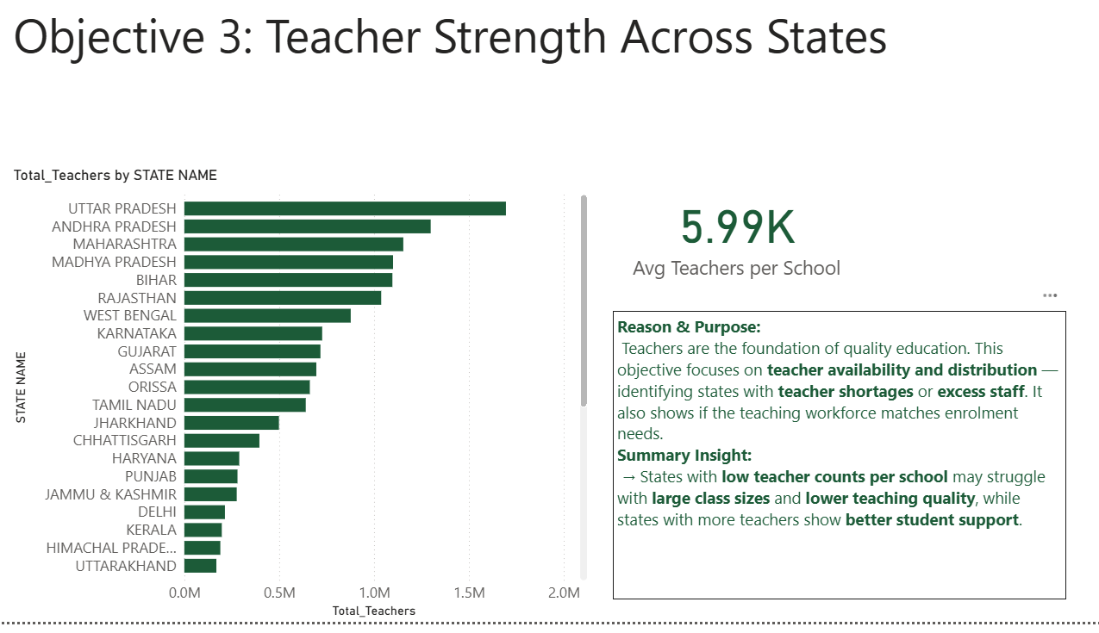

Slide 12
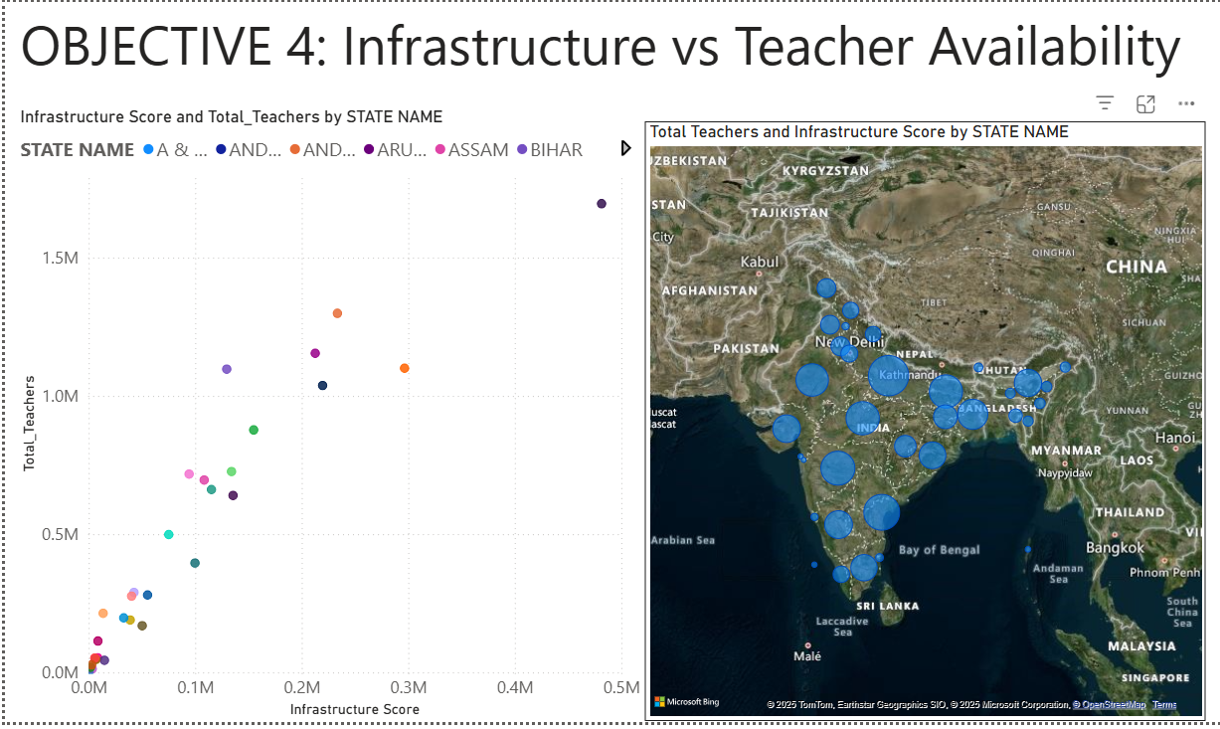

Slide 13
